Slide 1



Presentation On
Finding from My Research
Presented By
RAIBA MOLICK SUJAN
EDGE Roll: 07

Slide 2
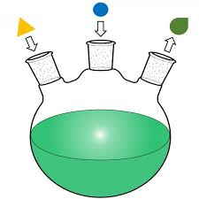
MY PRESENTATION OUTLINE
Introduction
Review of Literature
Synthesis
Results and discussion
Applications
Conclusion

Slide 3
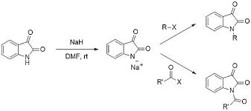
INTRODUCTION
ACID
Metal
Material
Product
Reactant
Isatin (1H-indole-2,3-dione) and its derivatives represent an important class of heterocyclic compounds that can be used as precursors for drug synthesis. Since its discovery, a lot of research work has been done regarding the synthesis, chemical properties, and biological and industrial applications of isatin.

Slide 4

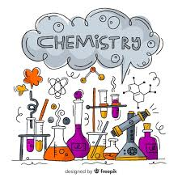

Review of Literature
The systematic and purposeful efforts undertaken by scholars, scientists, or researchers to investigate, explore, and contribute knowledge to a specific field or topic.

Slide 5


Synthesis of My Desired Product
To synthesize a product, a general approach involves identifying the starting material and desired product, planning a route using known reactions, selecting reagents and conditions, monitoring progress, optimizing conditions if necessary, and characterizing the final product.

Slide 6
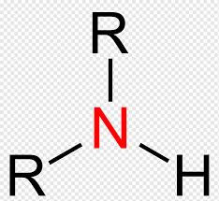
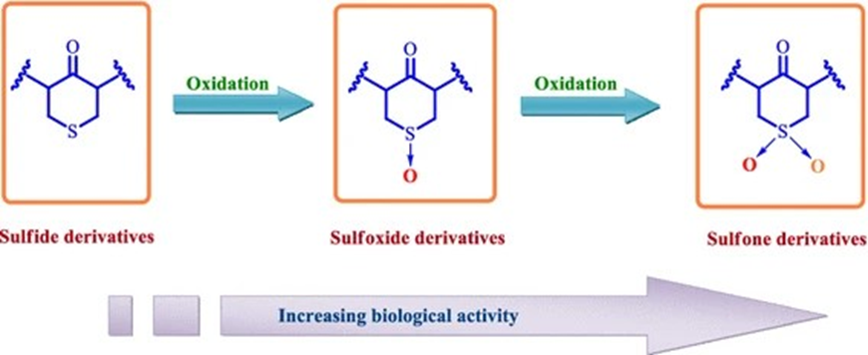
APPLICATION
Compound interest does not only apply to loans and investments. Concepts such as appreciation, depreciation, inflation, population growth and substance decay are examples of practical applications of compound interest.

Slide 7

CONCLUTION
DON'T introduce new information. Instead, your conclusion should restate your main points and provide closure. You may also offer suggestions on how your research can be expanded or improved. DO mention the limitations of your study and their implications if not already addressed in the discussion section of the paper.
THE END

